Slide 1
DSA 210 TERM PROJECT COVID -19 and the Rise of E-Commerce in Turkey (2018-2025)
COVID-19 and the Rise of E-Commerce in Turkey (2018–2025)
COVID-19 and the Rise of E-Commerce in Turkey (2018–2025)
COVID-19 and the Rise of E-Commerce in Turkey (2018–2025)
Şimal Karaköse 30840
09.01.2026

Slide 2


Introduction
This project analyzes the evolution of Turkey’s e-commerce market before, during, and after the COVID-19 pandemic. Using official national data from 2018 to 2025, it examines how the pandemic accelerated the shift toward online shopping and evaluates whether this growth represents a temporary shock or a long-term structural change in Turkey’s retail sector.

Slide 3

Motivation
COVID-19 caused a sharp change in consumer behavior worldwide.
In Turkey, e-commerce expanded rapidly as online shopping became a necessity.
After restrictions were lifted, the key question became whether this shift was permanent.
This project examines if consumer behavior returned to physical retail or remained digital.
A data-driven approach is used to analyze long-term changes in Turkey’s retail structure.

Slide 4
Research Questions
How did total e-commerce volume (₺) and number of transactions change from the pre-COVID period (2018–2019) to the post-COVID years (2022–2025)?
Did the share of e-commerce within total retail trade remain permanently higher after the pandemic compared to before?
How closely do online card spending trends correlate with overall e-commerce growth?

Slide 5
Data Collection and Preparation
Data Sources (2018–2023)
Constructed Indicators
Time Periods
🟦 Pre-COVID: 2018–2019
Forecasting (2024–2025)
• E-commerce share in total retail
• Internet card payment share
• E-commerce growth rate
• All values converted to billion ₺
• BKM: Online vs in-store card payments
• TÜİK: Total retail market (Retail Trade Index)
• Ministry of Trade (2019–2023): E-commerce volume & transactions
• TÜBİSAD (2018): Pre-COVID baseline
• Time-series prediction (no official data)
• Forecasted volume & transactions
• Confidence intervals
🟨 COVID Impact: 2020–2021
🟩 Post-COVID: 2022–2025 (incl. forecasts)

Slide 6
Descriptive Analysis of E-commerce Trends in Turkey

Slide 7
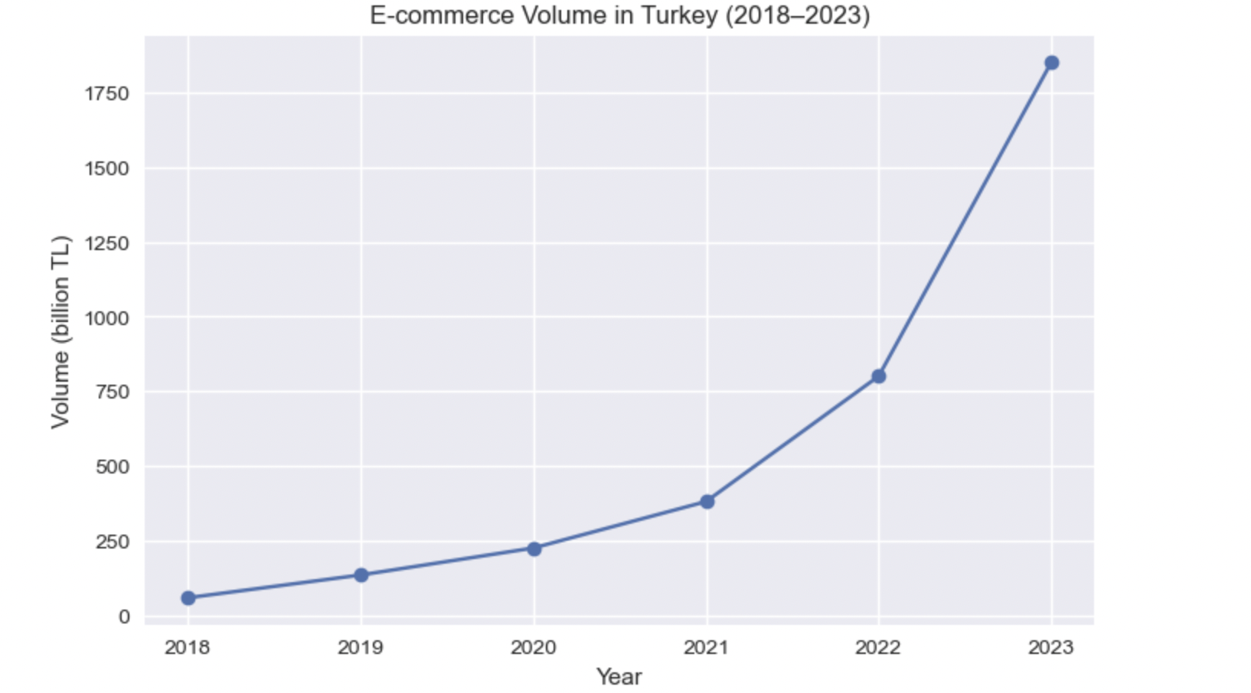
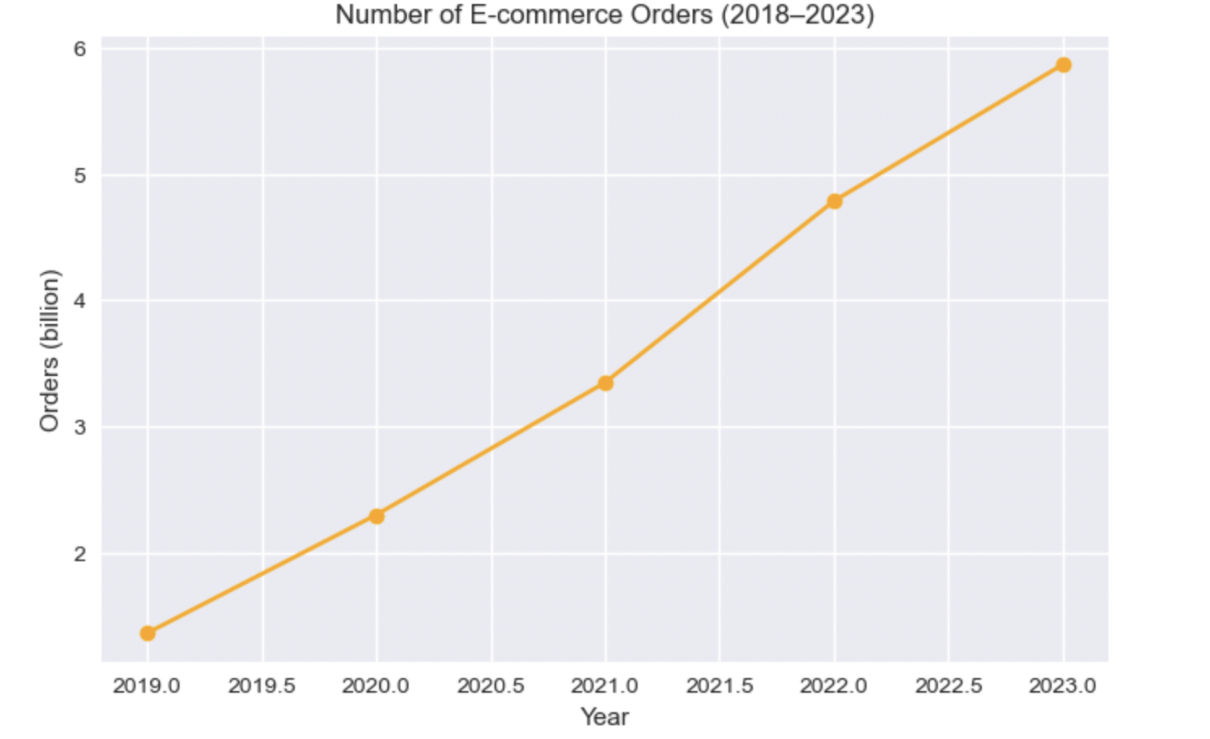
Analysis
E-commerce volume increases sharply after 2020, with a particularly strong rise in the post-COVID period.
The number of e-commerce orders follows a similar upward trend, indicating widespread adoption, not only price-driven growth.
The parallel increase in volume and orders suggests that COVID-19 created a lasting shift in consumer behavior, rather than a temporary spike.
Implied insight: Average spending per order also increased (volume grows faster than orders).

Slide 8
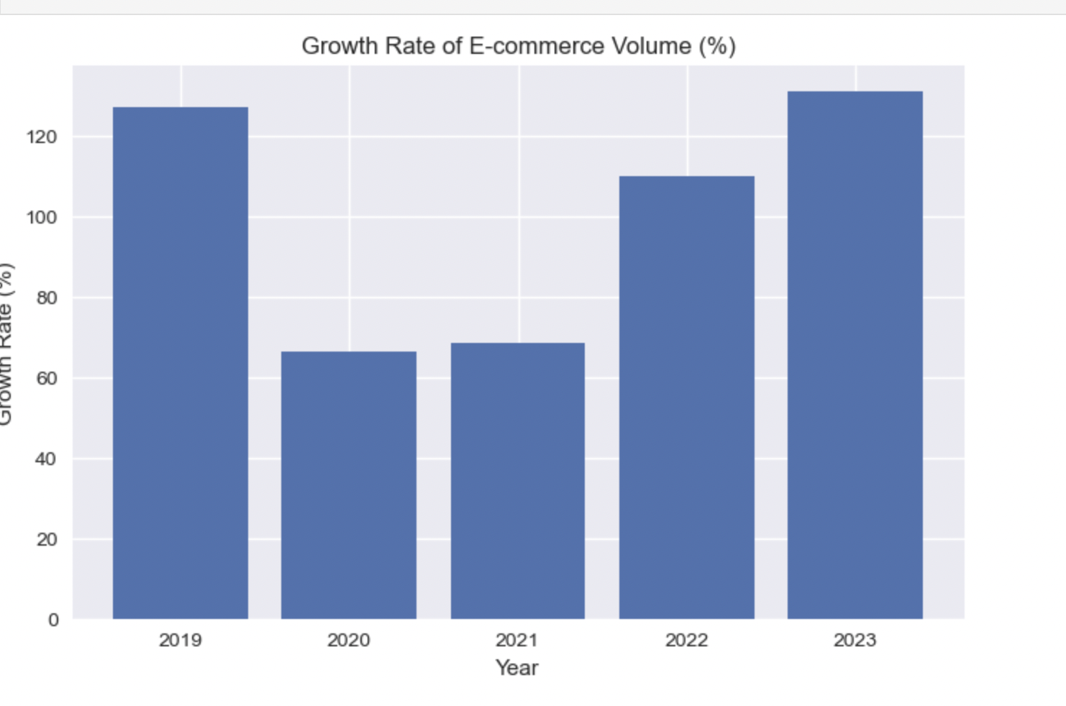
Analysis (cont.)
E-commerce growth accelerated strongly during the COVID period, confirming a clear shock-driven expansion.
Despite the easing of restrictions, growth rates remained high in 2022–2023, showing no reversal.
This pattern suggests that COVID-19 acted as a catalyst for long-term growth rather than a temporary disruption.
Growth rate calculated as year-over-year percentage change in e-commerce volume.

Slide 9
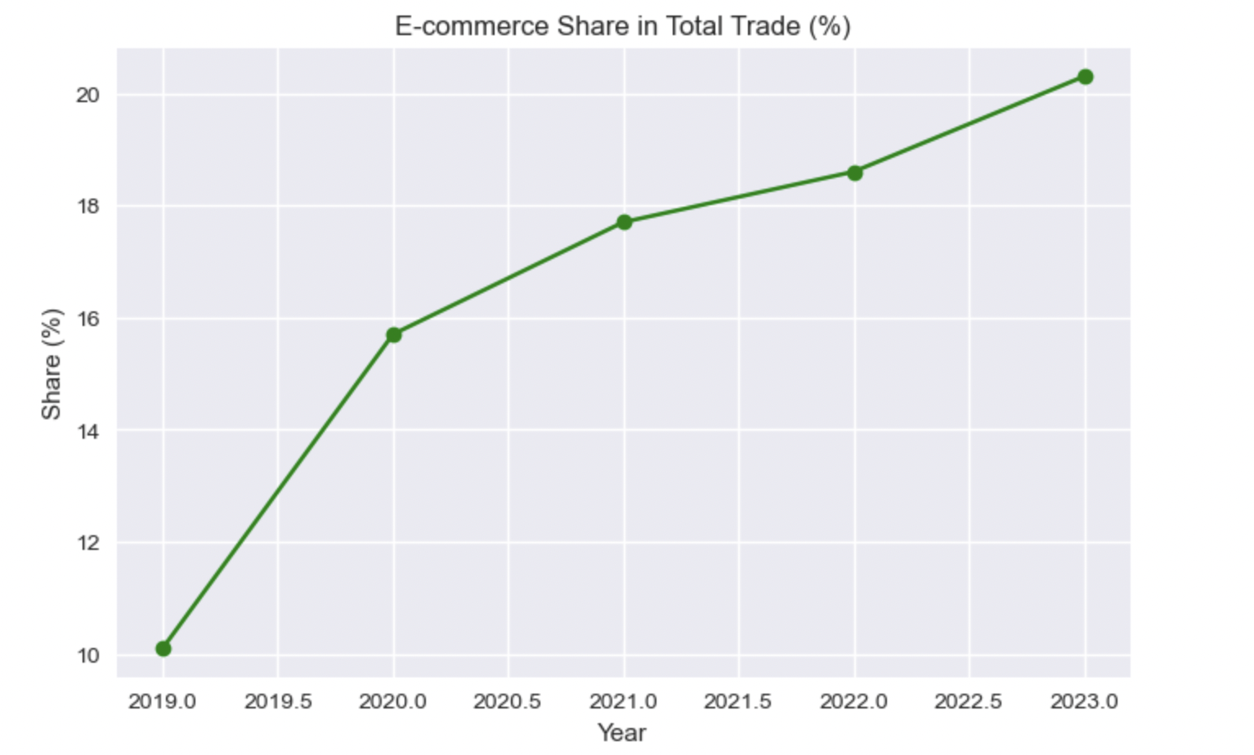
Analysis (cont.)
E-commerce’s share in total trade rises sharply during the COVID period.
After restrictions are lifted, the share continues to increase, rather than returning to pre-COVID levels.
This indicates a structural shift in Turkey’s retail market, with e-commerce becoming a permanent component of total trade.

Slide 10
Machine Learning Applications

Slide 11
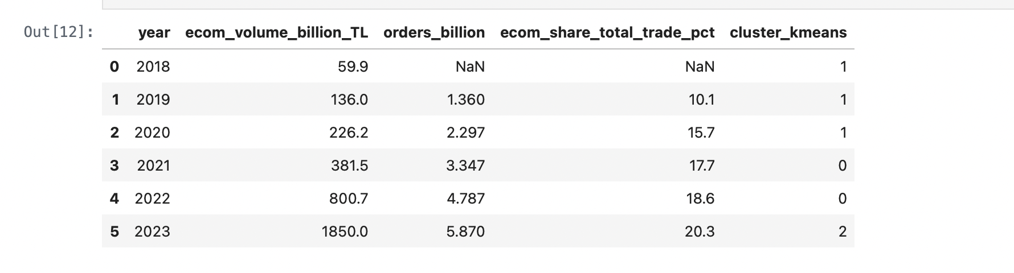
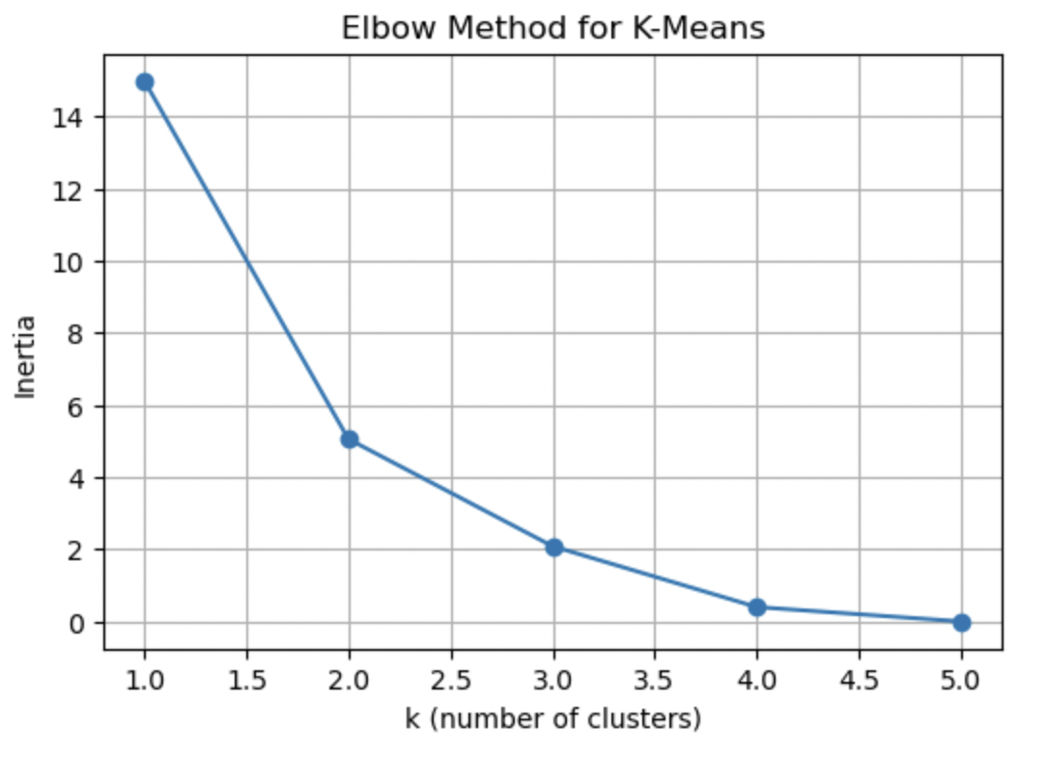
Analysis (cont.)
Using K-Means clustering with standardized e-commerce volume, order count, and market share variables, the optimal number of clusters is selected as k = 3 based on the Elbow Method. The resulting clusters reveal distinct market regimes, showing a clear transition from early adoption to post-COVID market maturity, indicating a structural shift in Turkey’s e-commerce landscape.

Slide 12
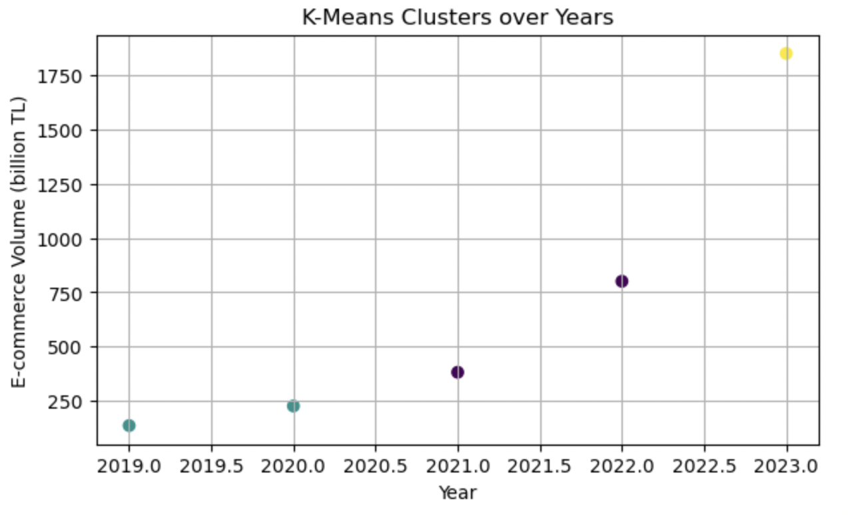
Analysis (cont.)
🟢 Green Circle → Early / Low Adoption Phase Low e-commerce volume and limited market penetration
🟣 Purple Circle → COVID-Driven Expansion Phase Rapid growth in volume and adoption
🟠 Orange Circle → Post-COVID High Maturity Phase Highest volume and market share
The clustering analysis reveals three distinct phases in Turkey’s e-commerce development. The early years are characterized by low adoption levels, while the COVID period corresponds to a clear acceleration and expansion phase. The post-COVID year forms a separate high-maturity cluster, indicating that the increase in e-commerce activity represents a lasting structural transformation rather than a temporary pandemic-driven surge.

Slide 13


Conclusion
Turkey’s e-commerce market experienced a sharp acceleration during COVID-19, with significant increases in volume, transaction counts, and market share.
Post-COVID analysis shows that e-commerce activity did not revert to pre-pandemic levels, but instead stabilized at a structurally higher level.
The continuous rise in e-commerce’s share within total trade provides strong evidence of a permanent shift in retail composition, rather than a temporary demand shock.
Growth rate dynamics indicate that while the COVID period acted as a catalyst, high growth persisted even after restrictions were lifted.
K-Means clustering identifies distinct market regimes (early adoption, COVID-driven expansion, post-COVID maturity), confirming a structural transformation in Turkey’s e-commerce landscape.
Forecast results for 2024–2025 further support the continuation of this trend, suggesting that digital retail has become a core component of Turkey’s long-term economic structure.

Slide 14
Sources
Ministry of Trade of the Republic of Türkiye. E-Commerce Statistics and Official Announcements (2019–2023).
TÜBİSAD & Deloitte. E-Commerce Market Report (2018).
Turkish Statistical Institute (TÜİK). Retail Trade Volume Index.
Interbank Card Center (BKM). Card Payment Statistics.

Slide 15
Thank you ☺

